Slide 1




Slide 2

RESUME SKILLS -1

Slide 3

RESUME SKILLS
Let’s start from the basics..
What is a resume?

Slide 4

RESUME SKILLS
Structure of a standard resume

Slide 5
RESUME SKILLS
How resume template helps ?
Organize Your Resume
No Experience Needed
Make a Great First Impression
Save Time

Slide 6
RESUME SKILLS
Risks with using templates :
Same as everyone else
A lot of the templates out there are substandard
You are selling yourself short
What a job seeker should do

Slide 7

RESUME SKILLS
What is the basic structure of a resume?

Slide 8
RESUME SKILLS
Sections in a resume :
Contact Information
Resume Summary
Experience
Certifications
Education
Skills

Slide 9

RESUME SKILLS
Resume format importance

Slide 10

RESUME SKILLS
TIPS FOR BETTER RESUME

Slide 11

RESUME SKILLS
Formatting - Use of color and font

Slide 12
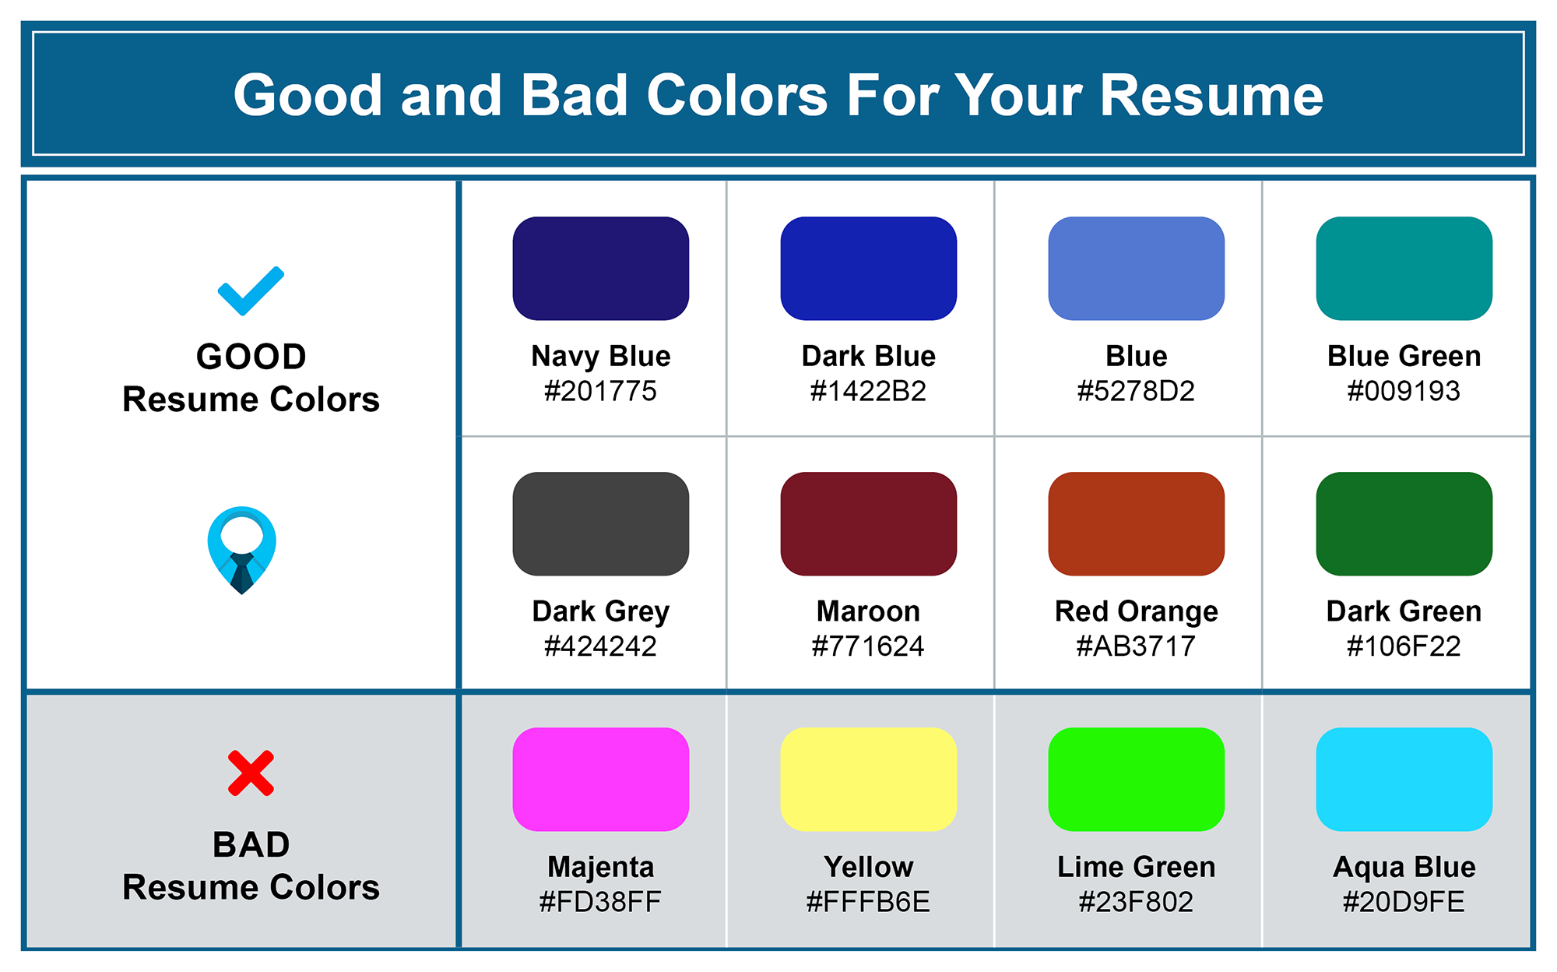
RESUME SKILLS

Slide 13
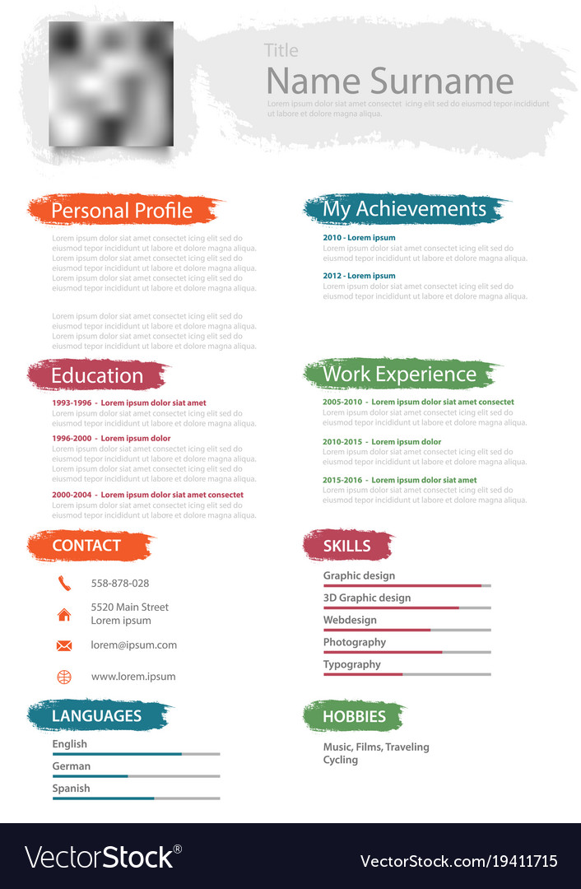
RESUME SKILLS

Slide 14
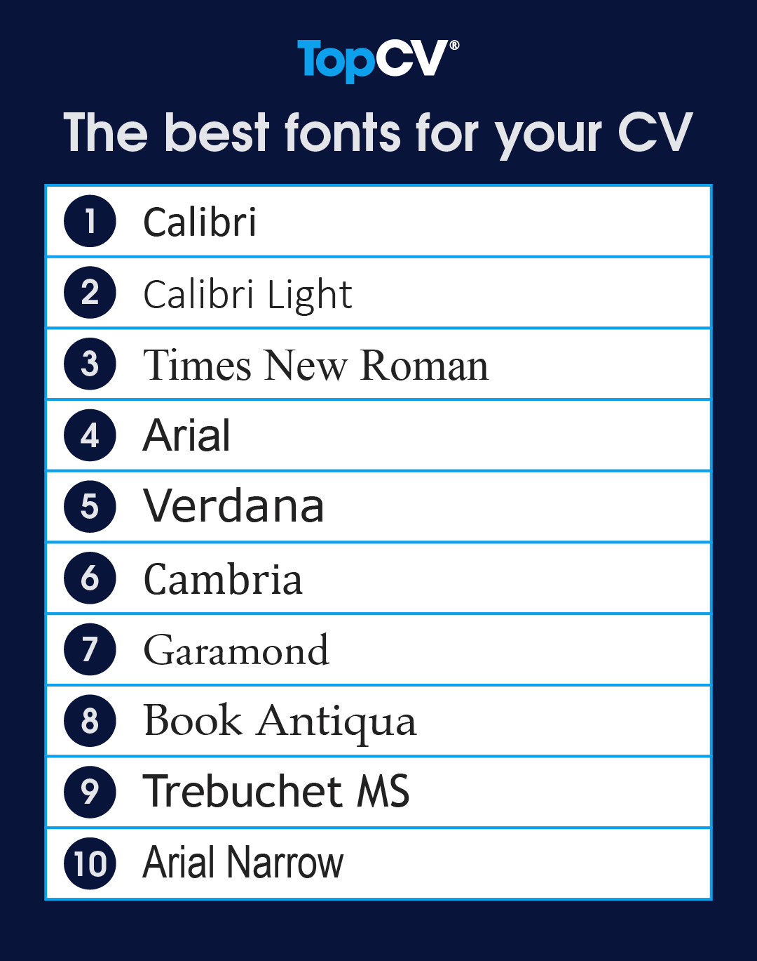
RESUME SKILLS
Use of font :
Serif
Times New Roman
Garamond
Georgia
Sans-serif
Arial
Calibri
Verdana

Slide 15

RESUME SKILLS

Slide 16

RESUME SKILLS
Introduction to Power verbs and Write up

Slide 17

RESUME SKILLS
What are Power verbs?

Slide 18
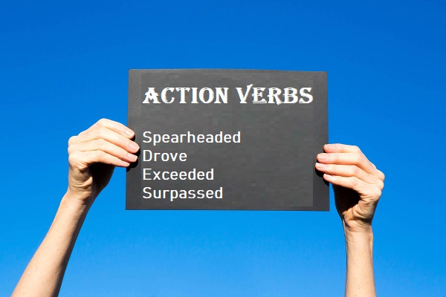
RESUME SKILLS
Benefits of Power verbs

Slide 19
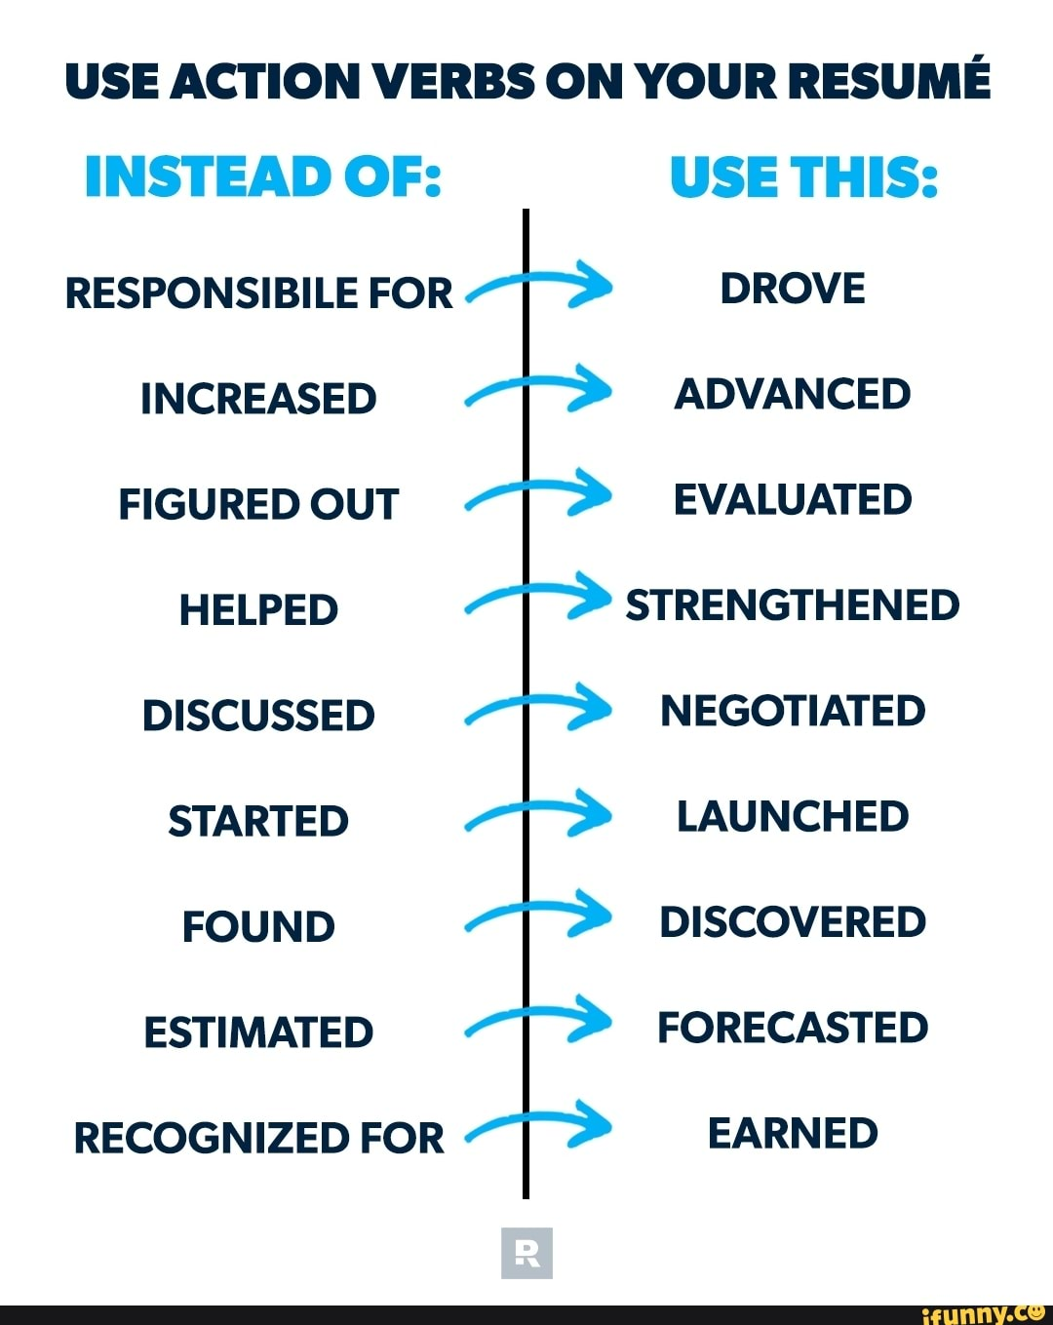
RESUME SKILLS

Slide 20
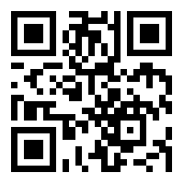
https://learn.codemithra.com

Slide 21




THANK YOU
+91 78150 95095
codemithra@ethnus.com
www.codemithra.com

